Slide 1
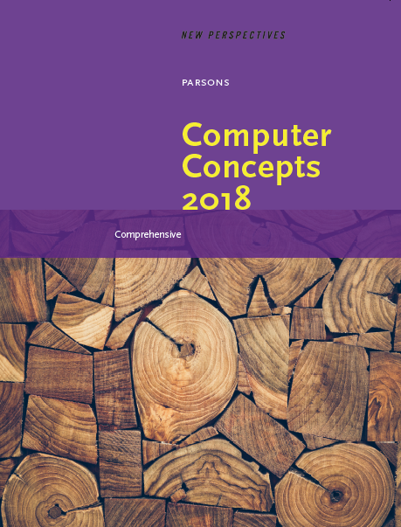

Computer Concepts 2018
Module 7
Digital Security
Copyright © 2019 Cengage. All rights reserved.

Slide 2
Module Contents
Section A: Basic Security
Section B: Malware
Section C: Online Intrusions
Section D: Interception
Section E: Social Engineering

Slide 3
Section A: Unauthorized Use
Encryption
Authentication
Passwords
Password Managers

Slide 4
Section A: Objectives (1 of 2)
List five examples in which digital data is encrypted for security purposes
Describe how two-factor authentication works when you log in to a Gmail account from a device you have never used before
Explain how encryption is linked to passcodes in some digital devices
Describe the advantages of encrypting an entire storage volume
Recite the basic rules for creating a strong password

Slide 5
Section A: Objectives (2 of 2)
List at least five characteristics of weak passwords
Recite the formula for calculating the number of possible passwords that can be generated using a four-digit PIN
Explain the concept of password entropy
Describe the advantages and disadvantages of local, cloud-based, and USB password managers

Slide 6
Encryption (1 of 3)
Encryption transforms a message or data file in such a way that its contents are hidden from unauthorized readers
An original message or file that has not yet been encrypted is referred to as plaintext or cleartext
An encrypted message or file is referred to as ciphertext
The process of converting plaintext into ciphertext is called encryption; the reverse process—converting ciphertext into plaintext—is called decryption

Slide 7
Encryption (2 of 3)
Data is encrypted by using a cryptographic algorithm and a key
A cryptographic algorithm is a procedure for encryption or decryption
A cryptographic key (usually just called a key) is a word, number, or phrase that must be known to encrypt or decrypt data
There are various encryption methods, and some are more secure than others; AES (Advanced Encryption Standard) is the encryption standard currently used worldwide

Slide 8
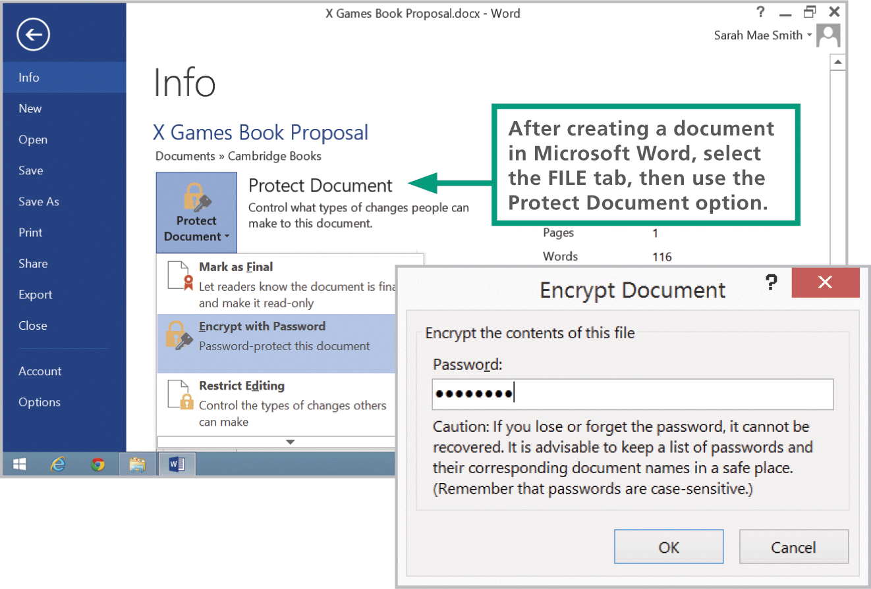
Encryption (3 of 3)

Slide 9
Authentication (1 of 4)
Authentication protocols, such as passwords, PINs, and fingerprint scans and facial recognition are the first line of defense against data thieves and snoopers
iPhones and iPads should be configured to require a login password, called a passcode, each time the device is used; the standard iOS security setting establishes a four-digit numeric passcode, similar to a PIN (personal identification number)

Slide 10
Authentication (2 of 4)
Android devices have an overwhelming number of security settings; Android devices do not automatically encrypt data stored on the device when a user activates the login password; configuring a password and activating encryption are two separate steps

Slide 11
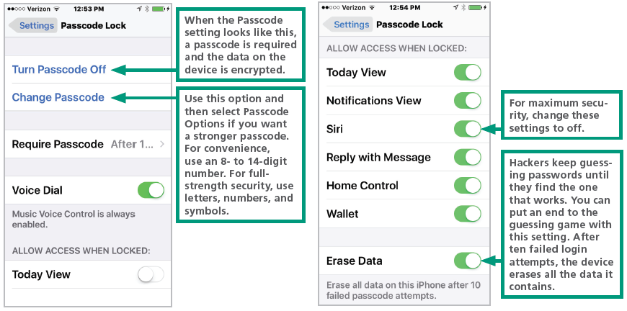
Authentication (3 of 4)

Slide 12
Authentication (4 of 4)
Windows offers several password options that can be configured using the Accounts utility, which is accessed from the Start menu or Control panel; Windows devices can be encrypted using Microsoft’s BitLocker or third-party utilities
Macs offer several password settings, which are accessed from the Security & Privacy preferences; a feature called Automatic Login allows access to a device without a password

Slide 13
Strong Passwords (1 of 10)
A strong password is difficult to hack; conventional wisdom tells us that strong passwords are at least eight characters in length and include one or more uppercase letters, numbers, and symbols

Slide 14
Strong Passwords (2 of 10)
A brute force attack uses password-cracking software to generate every possible combination of letters, numerals, and symbols. Because it exhausts all possible combinations to discover a password, it can run for days before a password is cracked
A dictionary attack helps hackers guess your password by stepping through a dictionary containing word lists in common languages such as English, Spanish, French, and German

Slide 15
Strong Passwords (3 of 10)
Dictionary attacks are effective because many users choose passwords that are easy to remember and likely to be in the most commonly used list
12345 | 000000 | buster | coffee | eeyore
abc123 | money | dragon | dave | fishing
password | carmen | jordan | falcon | football
p@sswOrd | mickey | michael | freedom | george
Pa55word | secret | michelle | gandalf | happy
passwordl | summer | mindy | green | iloveyou
!qaz2wsx | internet | patrick | helpme | jennifer
computer | service | 123abc | linda | jonathan
123456 | canada | andrew | magic | love

Slide 16
Strong Passwords (4 of 10)
111111 | hello | calvin | merlin | marina
a1b2c3 | ranger | changeme | molson | master
qwerty | shadow | diamond | newyork | missy
adobe123 | baseball | matthew | soccer | monday
123123 | donald | miller | thomas | monkey
admin | harley | ou812 | wizard | natasha
1234567890 | hockey | tiger | Monday | ncc1701
photoshop | letmein | 12345678 | asdfgh | newpass
1234 | maggie | apple | bandit | pamela
sunshine | mike | avalon | batman
azerty | mustang | brandy | boris
trustno1 | snoopy | chelsea | dorothy

Slide 17
Strong Passwords (5 of 10)
Many of the clever schemes users devise to create passwords are obvious to hackers and the programmers who create password-cracking tools
Weak passwords include the following:
Words from a dictionary, including words that are in languages other than English
Doubled words such as passpass or computercomputer
Default passwords such as password, admin, system, and guest
Sequences of numbers formatted as dates or telephone numbers, such as 01/01/2000 and 888-5566

Slide 18
Strong Passwords (6 of 10)
Words with a sequence of numbers at the end, such as Secret123 and Dolphins2018
Words with symbol or numeric mutations, such as p@ssw0rd and V01dem0rt
Any sequence that includes a user name, such as BillMurray12345
Any sequence that uses conventional capitalization, such as Book34 and Savannah912

Slide 19
Strong Passwords (7 of 10)
Start with a phrase. Base your high-security password on the first letters of a phrase that generates a password containing numbers and proper nouns.
Aim for a length of 8 to 12 characters because some sites limit password length.
Use uppercase letters somewhere other than at the beginning of the password.
Use numbers somewhere other than at the end of the password.
Some sites do not allow symbols, so you may not want to use them in a password that will be modified for use on many sites.

Slide 20
Strong Passwords (8 of 10)
Here is an example of a phrase that produces a fairly secure password:
I went to Detroit Michigan when I was 23 years old IwtDMwiw23yo
Add the site name. By inserting the name of the site, every password will be unique and you will be able to remember the site on which it is used, like this:
I went to PayPal when I was 23 years old IwtPayPalwiw23yo

Slide 21
Strong Passwords (9 of 10)
Make a low-security password. A password achieves pretty good entropy when it is composed of four or more words. Create an everyday password using this method. Here is an example: SpaBraidAmazonNuit
Be careful what you write. If you have to write down your passwords to remember them, keep them in a safe place that is not connected to your digital device. If your device is stolen, the passwords should not be located where they would also be stolen.

Slide 22
Strong Passwords (10 of 10)
Use encryption. If you want to store passwords on your device, make sure to encrypt the file in which they are stored.
Use a password manager. If you feel more secure with a totally random and unique password for each of your logins, a password manager is an excellent option.

Slide 23
Password Managers (1 of 2)
The core function of a password manager (sometimes called a keychain) is to store user IDs with their corresponding passwords
Password managers may also include a strength meter that indicates password security—a feature that is useful if you create a custom password rather than using one generated by the password manager

Slide 24
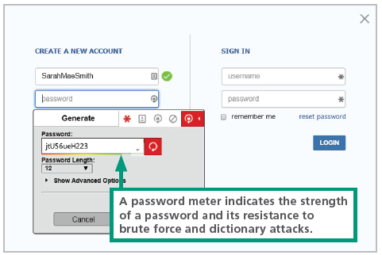
Password Managers (2 of 2)

Slide 25
Section B: Malware
Malware Threats
Computer Viruses
Computer Worms
Trojans
Antivirus Software

Slide 26
Section B: Objectives (1 of 2)
List at least five examples of malware payloads
Describe the characteristics that differentiate computer viruses from other types of malware
Explain the purpose of a rootkit
Describe the characteristics of computer worms and list three common infection vectors
Explain the purpose of malware trojans and how they relate to droppers
List the two ways that antivirus software is able to detect viruses

Slide 27
Section B: Objectives (2 of 2)
Explain the three possible actions that antivirus software can take when a virus is detected
Explain the significance of false positives in the context of virus detection
Describe how to determine if an email warning about a virus is real or a hoax

Slide 28
Malware Threats (1 of 3)
Malware refers to any computer program designed to surreptitiously enter a digital device
The action carried out by malware code is referred to as a malware exploit or payload
Common classifications of malware include:
Viruses
Worms
Trojans

Slide 29
Malware Threats (2 of 3)
Display irritating messages and pop-up ads Delete or modify your data
Encrypt data and demand ransom for the encryption key
Upload or download files
Record keystrokes to steal passwords and credit card numbers
Send messages containing malware and spam to everyone in an email address book or instant messaging buddy list
Disable antivirus and firewall software

Slide 30
Malware Threats (3 of 3)
Block access to specific Web sites and redirect a browser to infected Web sites Cause response time slowdowns
Allow hackers to remotely access data stored on a device
Allow hackers to take remote control of a device and turn it into a zombie
Link a device to others in a botnet that can send millions of spam emails or wage denial-of-service attacks against Web sites
Cause network traffic jams

Slide 31
Computer Viruses (1 of 3)
A computer virus is a set of self-replicating program instructions that surreptitiously attaches itself to a legitimate executable file on a host device
Today, viruses are a mild threat; they do not spread rapidly, and they are easily filtered out by antivirus software
Viruses reveal the basic techniques that are still used to inject third-party code into legitimate data streams
Code injection is the process of modifying an executable file or data stream by adding additional commands

Slide 32
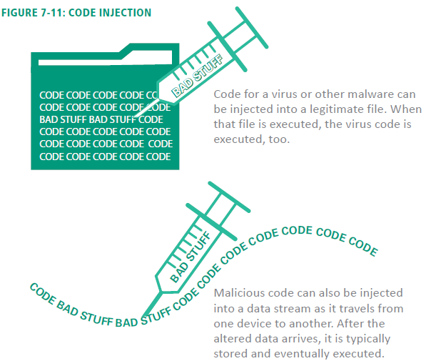
Computer Viruses (2 of 3)

Slide 33
Computer Viruses (3 of 3)
Viruses spread when people exchange infected files on disks and CDs, as email attachments, and on file sharing networks; they can also be inadvertently obtained from unauthorized app stores
Through a process called side-loading, an app from a source other than an official app store is installed on a device
Any code that is designed to hide the existence of processes and privileges is referred to as a rootkit; these were originally designed to allow “root” or administrative access to digital devices and computer systems

Slide 34
Computer Worms (1 of 2)
A computer worm is a self-replicating, self-distributing program designed to carry out unauthorized activity on a victim’s device
A mass-mailing worm spreads by sending itself to every address in the address book of an infected device
An internet worm looks for vulnerabilities in operating systems, open communication ports, and JavaScripts on Web pages
A file-sharing worm copies itself into a shared folder under an innocuous name

Slide 35
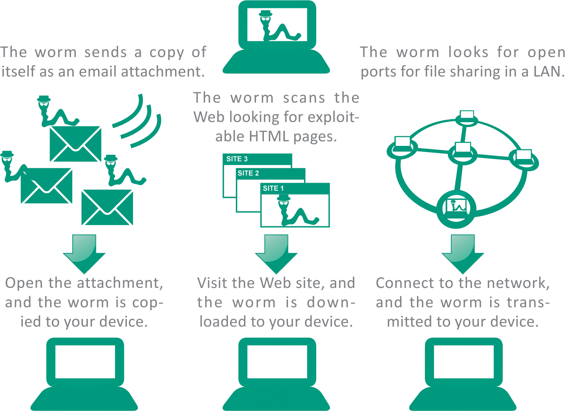
Computer Worms (2 of 2)

Slide 36
Trojans (1 of 2)
A trojan (sometimes called a “Trojan Horse”) is a computer program that seems to perform one function while actually doing something else. Most trojans are not designed to replicate themselves
A dropper is designed to deliver or “drop” malicious code into a device; they are usually the first phase of a sophisticated malware attack

Slide 37
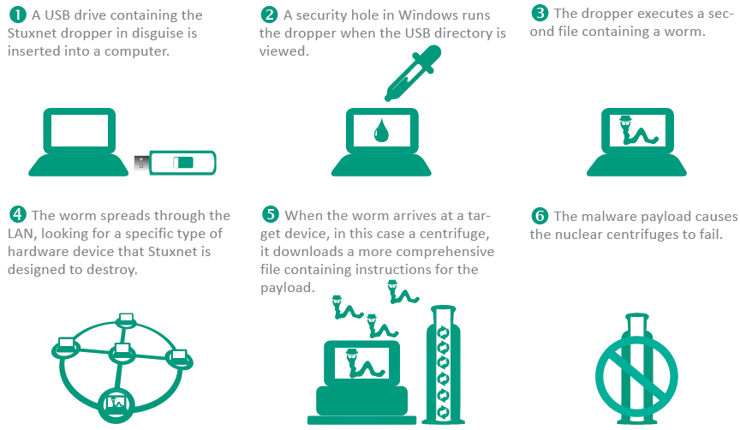
Trojans (2 of 2)

Slide 38
Antivirus Software (1 of 8)
Antivirus software is a type of utility software that looks for and eliminates viruses, trojans, worms, and other malware
A virus signature is a section of program code that contains a unique series of instructions known to be part of a malware exploit; they are discovered by security experts who examine the bit sequences contained in malware program code

Slide 39
Antivirus Software (2 of 8)
Antivirus software can use techniques called heuristic analysis to detect malware by analyzing the characteristics and behavior of suspicious files
Heuristics may produce false positives that mistakenly identify a legitimate file as malware

Slide 40
Antivirus Software (3 of 8)
Repair. Antivirus software can sometimes remove the malware code from infected files. This strategy is benefi­cial for files containing important documents that have become infected. Many of today's malware exploits are embedded in executable files and are difficult to remove. When malware cannot be removed, the file should not be used.
Quarantine. In the context of antivirus software, a quarantined file contains code that is suspected of being part of a virus. For your protection, most antivirus software encrypts the file's contents and isolates it in a quarantine folder so it can't be inadvertently opened or accessed by a hacker.

Slide 41
Antivirus Software (4 of 8)
Quarantined files cannot be run, but they can be moved out of quarantine if they are later found to have been falsely identified as malware.
Delete. Quarantined files should eventually be deleted. Most antivirus software allows users to specify how long an infected file should remain in quarantine before it is deleted. Most users rarely retrieve files from quarantine because it is risky to work with files that are suspected of harboring malicious code. There is no need, therefore, to delay deletion for more than a few days.

Slide 42
Antivirus Software (5 of 8)
For the most extensive protection from malware, you should look for and enable the following features of your antivirus software:
Start scanning when the device boots
Scan all programs when they are launched, and scan document files when they are opened
Scan other types of files, such as graphics, if you engage in some risky computing behaviors and are not concerned with the extra time required to open files as they are scanned
Scan incoming email and attachments
Scan incoming instant message attachments

Slide 43
Antivirus Software (6 of 8)
Scan outgoing email for worm activity such as mass-mailing worms
Scan zipped (compressed) files.
Scan for spyware and PUAs (potentially unwanted applications)
Scan all files on the device's storage volume at least once a week

Slide 44
Antivirus Software (7 of 8)
Some virus threats are very real, but you’re also likely to get email messages about so-called viruses that don’t really exist
A virus hoax usually arrives as an email message containing dire warnings about a supposedly new virus on the loose
Never forward a viral email to others, even if you think it’s just a virus hoax

Slide 45
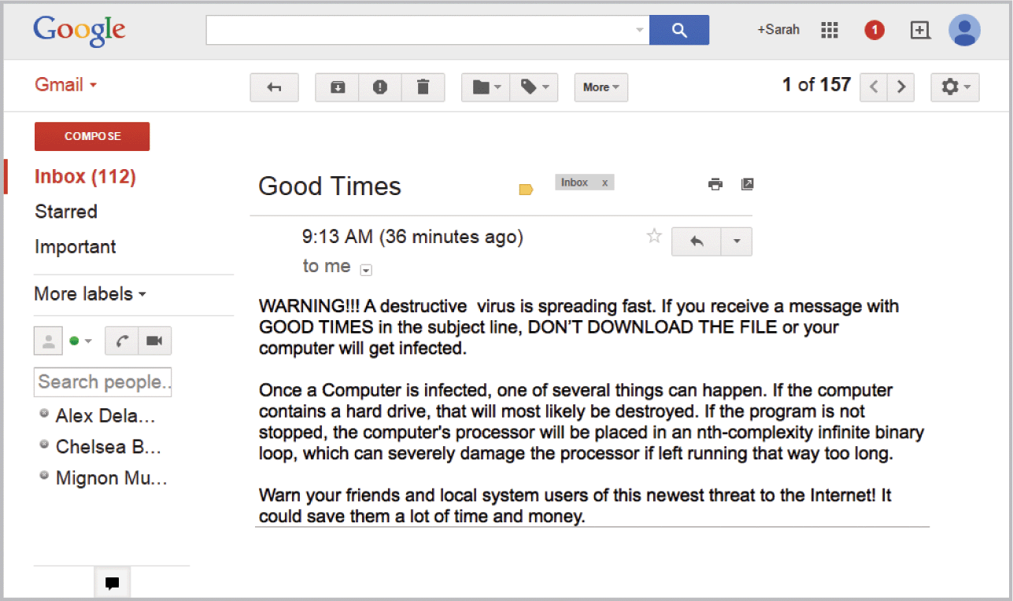
Antivirus Software (8 of 8)

Slide 46
Section C: Online Intrusions
Intrusion Threats
Anti-exploit Software
Netstat
Firewalls

Slide 47
Section C: Objectives (1 of 2)
Provide an overview that describes how an online intrusion takes place.
List and describe at least seven types of online intrusions
Explain how a DDoS attack takes place
Describe the difference between an on-demand scan and on-access scanning
Summarize the significance of communications ports in online intrusions
State the purpose of a personal firewall and describe how one works

Slide 48
Section C: Objectives (2 of 2)
Explain how NAT works in conjunction with a router to provide a hardware firewall
Explain why security experts recommend using both NAT and a personal firewall
Describe the security vulnerability associated with remote access utilities

Slide 49
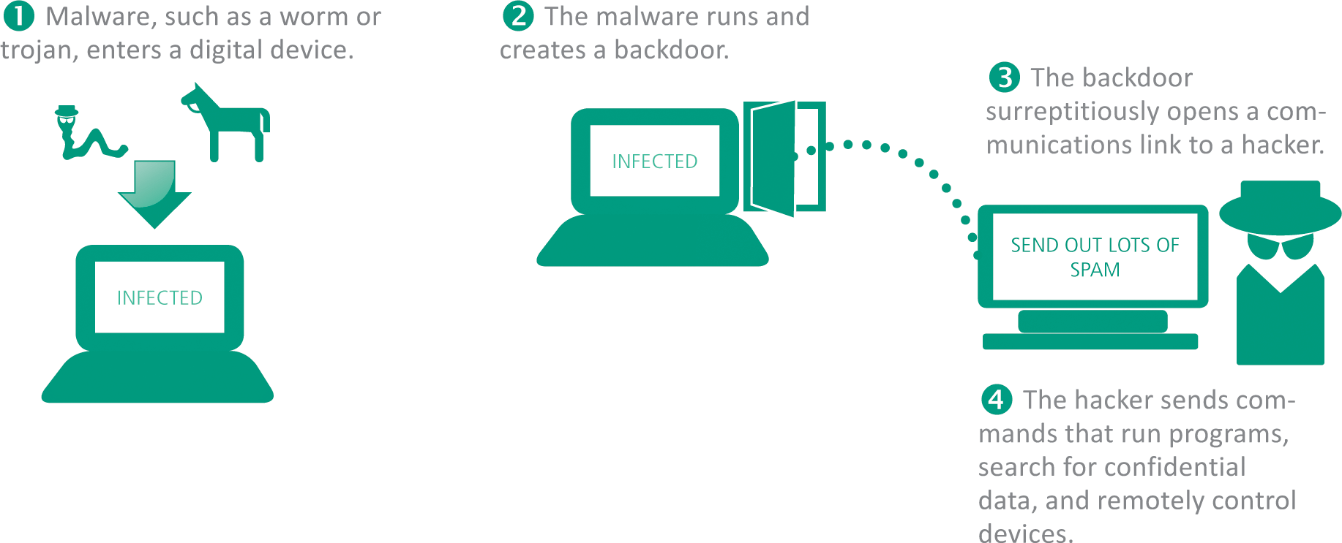
Intrusion Threats (1 of 3)
An online intrusion takes place when an unauthorized person gains access to a digital device by using an Internet connection and exploiting vulnerabilities in hardware or software

Slide 50
Intrusion Threats (2 of 3)
Different types of intrusions include:
RATs (Remote Access Trojan) – malware that arrives in a trojan disguised as a legitimate software; sets up a secret communication link with the hacker
Backdoor is an undocumented method of accessing a digital device
Ransomware – locks a device and then requests payment for an unlocking code; commonly exploits the Find My iPhone feature

Slide 51
Intrusion Threats (3 of 3)
Botnets – a client-server network created by hackers who gain control over several computers; this network is hidden from the victims, who continue to use their devices
DDoS (distributed denial of service) – attacks designed to flood a legitimate Web site or Internet router with so much traffic that it can no longer function

Slide 52
Anti-exploit Software
A zero-day attack exploits previously unknown vulnerabilities in software applications, hardware, and operating system program code
Anti-exploit security software offers an additional defense against zero-day attacks
Anti-exploit software shields certain applications against behaviors commonly exhibited by intrusions and other exploits

Slide 53
Firewalls (1 of 3)
A firewall is a device or software that is designed to block unauthorized access while allowing authorized communications
A personal firewall uses a set of rules to block data or allow it to enter a digital device
Most personal firewalls are configured to block all communication unless an app and its corresponding communication port are on a list of allowed exceptions

Slide 54
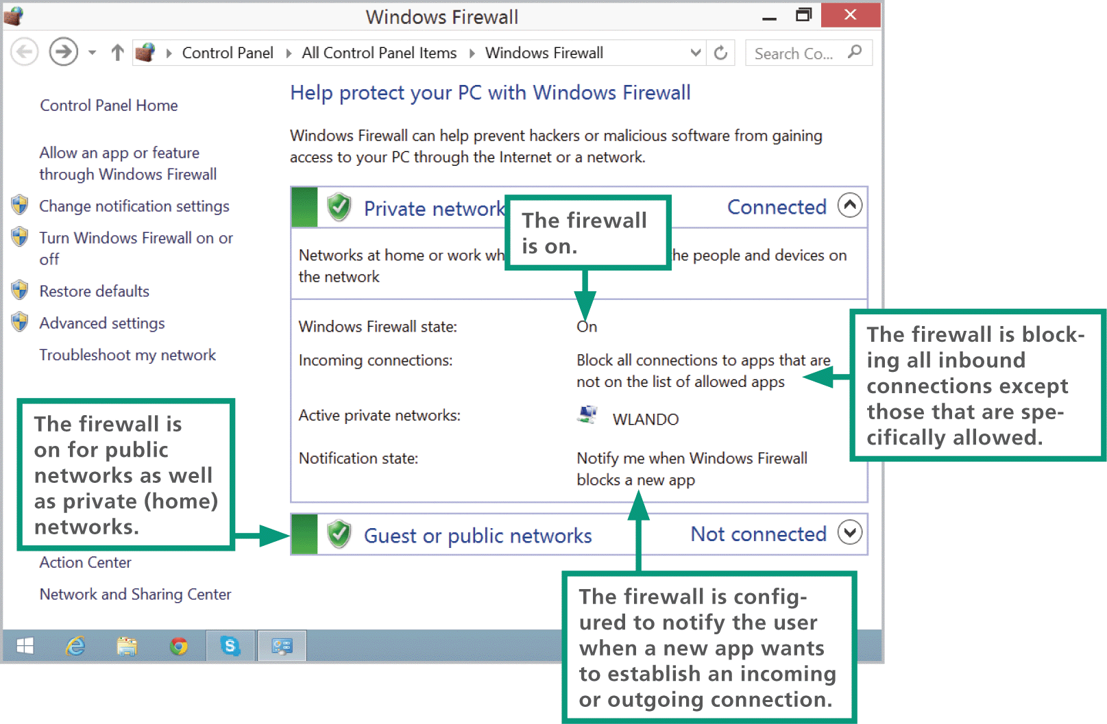
Firewalls (2 of 3)

Slide 55
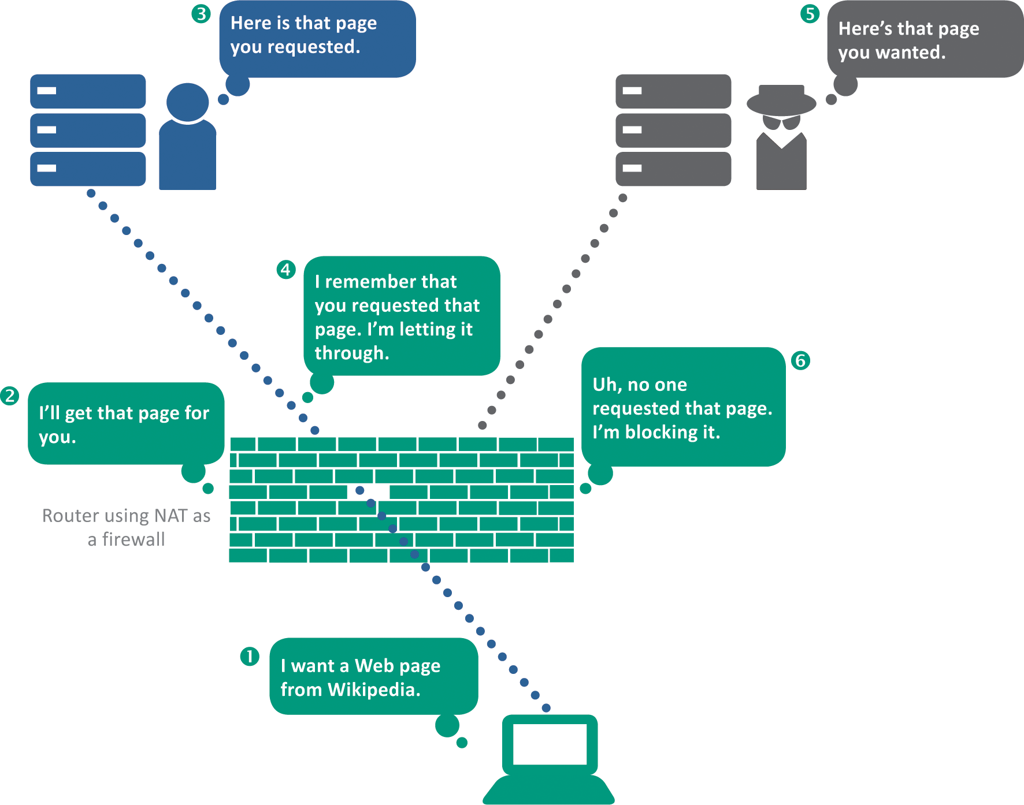
Firewalls (3 of 3)

Slide 56
Section D: Interception
Interception Basics
Evil Twins
Address Spoofing
Digital Certificate Hacks
IMSI Catchers

Slide 57
Section D: Objectives
List four types of intercept exploits
Draw a diagram illustrating a basic man-in-the-middle exploit
Describe the Evil Twin exploit and how to avoid it
List four types of address spoofs
List the three important security components of a digital certificate
Describe or diagram how a digital certificate encrypts the connection between a client and a server
Explain how a fake digital certificate can defeat encryption.
Describe how an IMSI catcher works

Slide 58
Interception Basics (1 of 3)
Interception exploits that are current threats to consumers include the following:
Spyware – any software that secretly gathers personal information without the victim’s knowledge
Adware – monitors Web browsing activity to supply ad-serving sites with data used to generate targeted ads

Slide 59
Interception Basics (2 of 3)
Keyloggers – a common type of spyware, it records keystrokes and sends them to a hacker who sifts out user passwords to access the victim’s accounts; often used by identity thieves and industrial spies
Man-in-the-Middle (MITM) – in the context of cyber security, it is an eavesdropping exploit; MITM attacks include Evil Twins, address spoofing, digital certificate hacks, and IMSI catchers

Slide 60
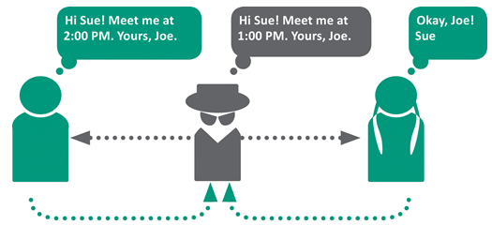
Interception Basics (3 of 3)
In an MITM attack, two parties believe they are communicating directly with each other when, in fact, they are communicating with a third party.

Slide 61
Evil Twins (1 of 2)
An Evil Twin is a LAN server that is designed to look like a legitimate Wi-Fi hotspot
Evil Twins are difficult to detect; to avoid this exploit, refrain from entering sensitive data while using any questionable network, and avoid using unsecured networks

Slide 62
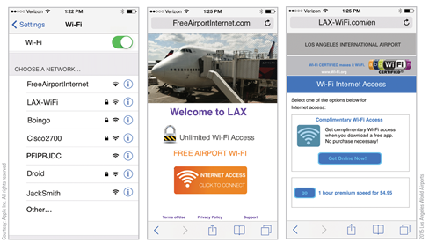
Evil Twins (2 of 2)
Three public Wi-Fi services appear to be offered at the LAX airport: FreeAirportInternet, LAX-WiFi, and Boingo. The remaining Wi-Fi hotspots are operated by individuals using their phones as a tethering device. Of the three public Wi-Fi services, FreeAirportInternet is not secured; therefore, it is most likely to be an Evil Twin.

Slide 63
Address Spoofing (1 of 2)
Broadly speaking, address spoofing changes an originating address or a destination address to redirect the flow of data between two parties
In the context of security exploits, address spoofing can take place on various levels of communication
Email address spoof
Changes the sender’s address. The spoofed address masks the source of spam.
IP address spoof
Modifies the source IP address of data packets used in a denial-of-service attack.

Slide 64
Address Spoofing (2 of 2)
DNS address spoof
Changes the IP address that corresponds to a URL. The spoofed URL directs victims to a fraudulent Web site.
ARP address spoof
Changes the ARP (Address Resolution Protocol) routing table on a local area network. The spoofed address redirects traffic through a secondary, potentially malicious device.

Slide 65
Digital Certificate Hacks (1 of 3)
The current method of encrypting communication between a client and a server depends on a security protocol called TLS (Transport Layer Security)
TLS checks a digital certificate to verify a server’s identity and pass a public key to the client
The client then uses the public key to encrypt data that is sent to the server

Slide 66
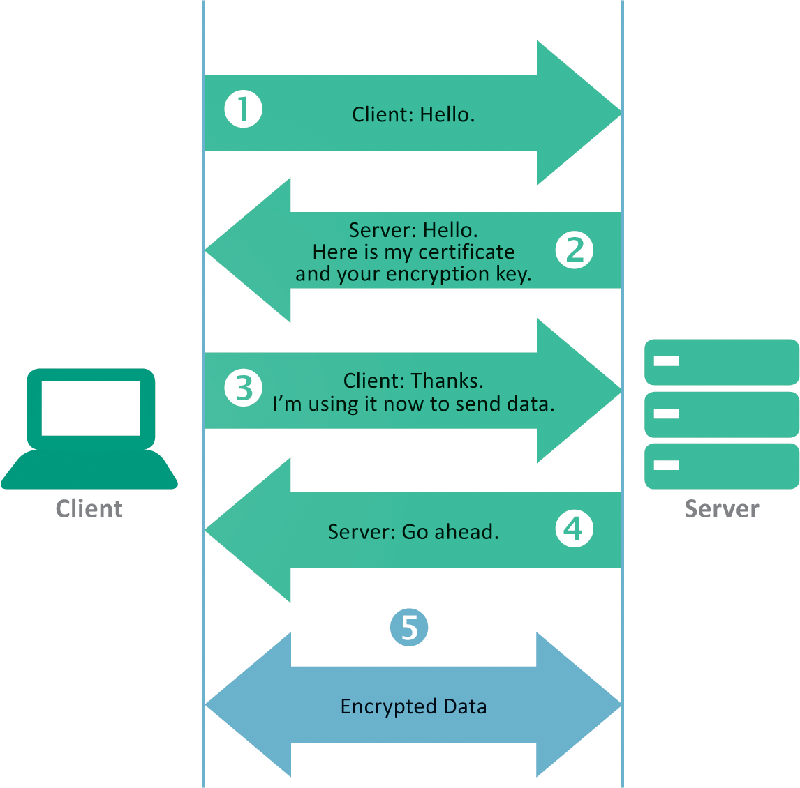
Digital Certificate Hacks (2 of 3)

Slide 67
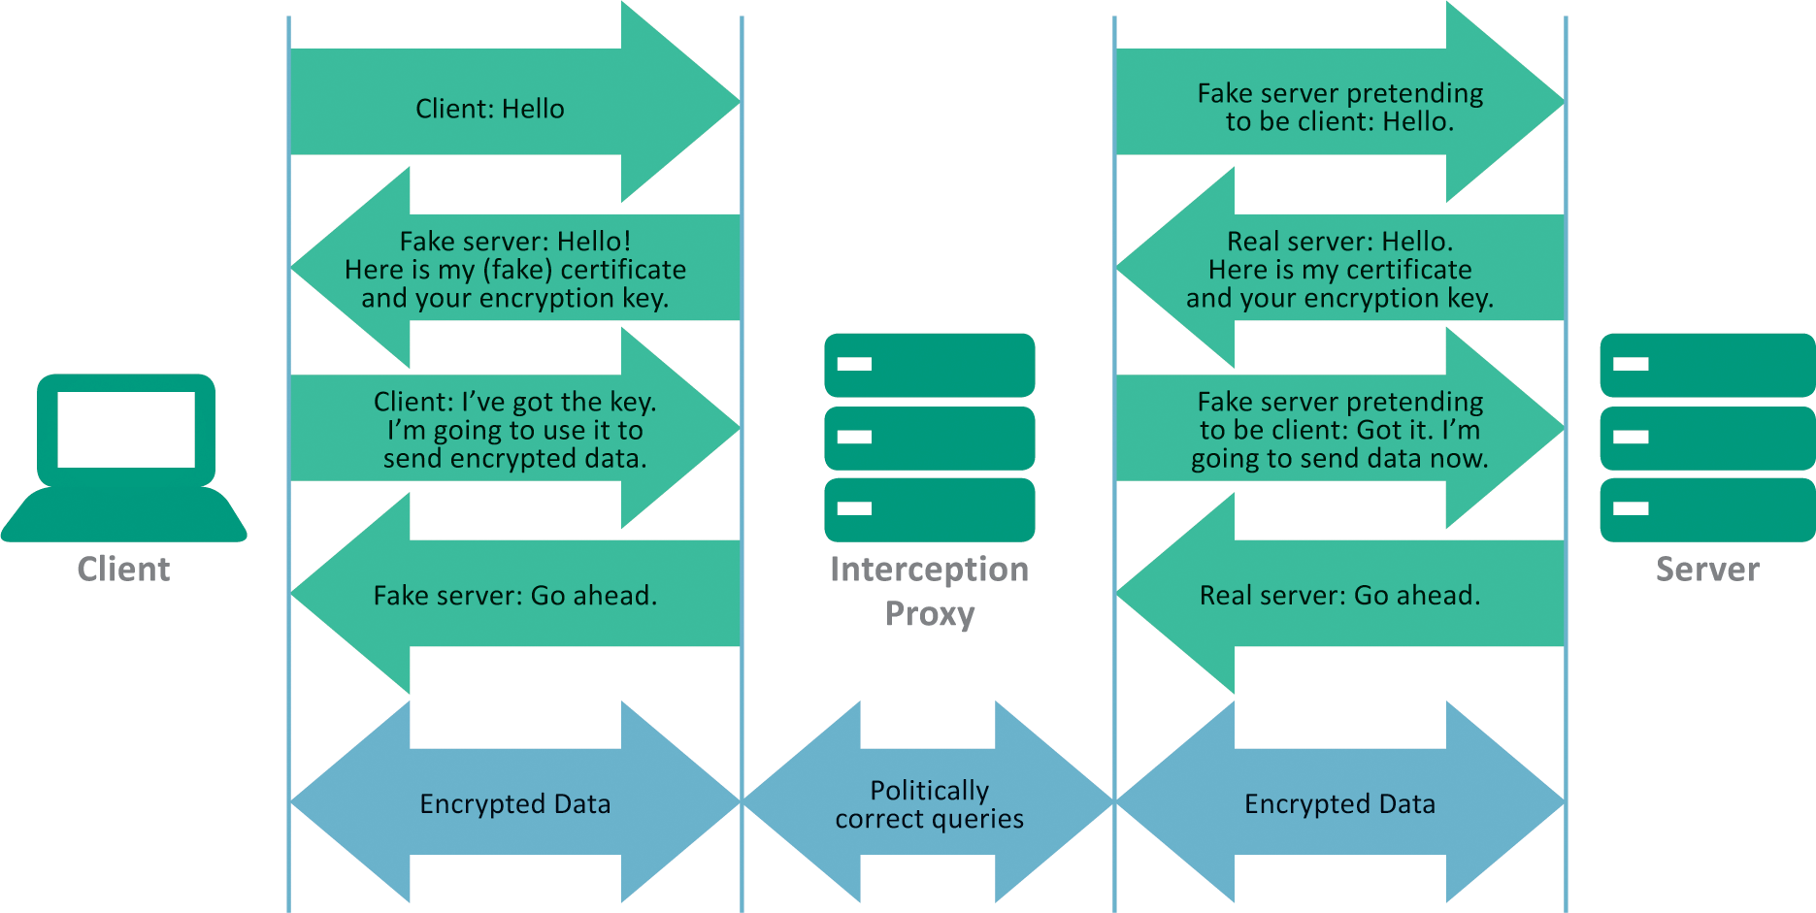
Digital Certificate Hacks (3 of 3)

Slide 68
IMSI Catchers (1 of 2)
IMSI is an acronym for International Mobile Subscriber Identity
It is a 64-bit number that uniquely identifies a cellular device
An IMSI catcher is an eavesdropping device used for intercepting mobile phone signals and tracking the location of cellular devices
IMSI catchers are used for MITM attacks

Slide 69
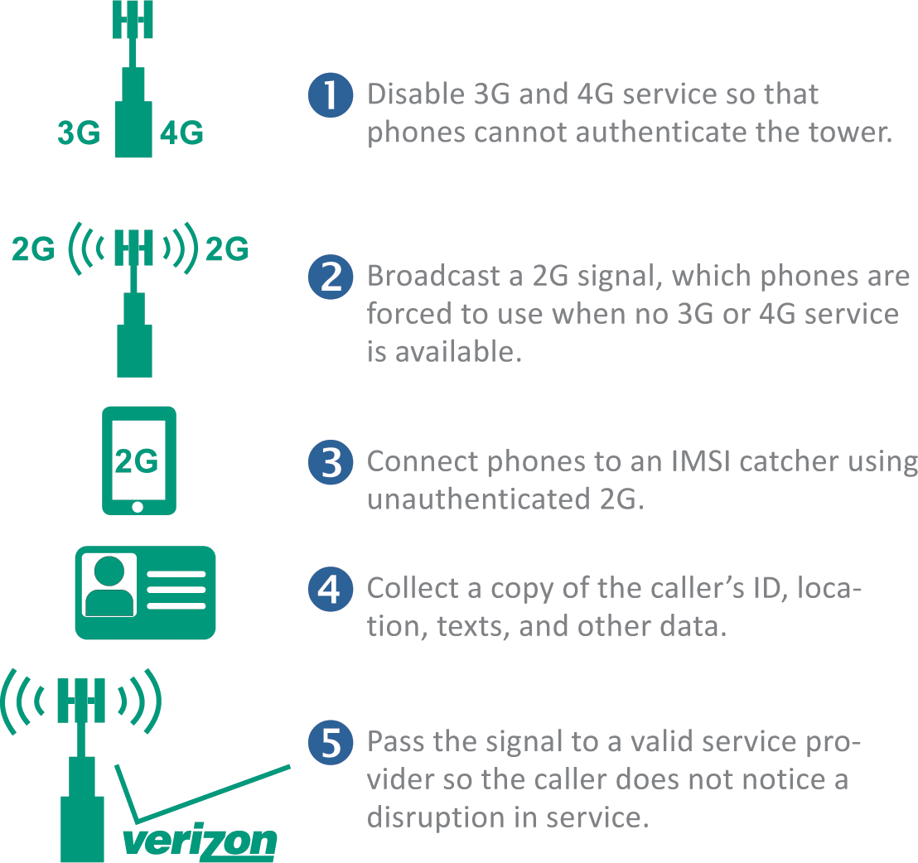
IMSI Catchers (2 of 2)

Slide 70
Section E: Social Engineering
Social Engineering Basics
Spam
Phishing
Pharming
Rogue Antivirus
PUAs

Slide 71
Section E: Objectives
Create a diagram that illustrates the six elements of a social engineering attack
Describe advance fee fraud and the stranded traveler scam
List the three limitations placed on spam by the CAN-SPAM Act of 2003
List at least six best practices for avoiding spam
Describe the four types of spam filters
Explain the difference between phishing and pharming attacks
Explain the purpose of Safe Browsing
Describe how a rogue antivirus exploit works
Give two examples of PUAs

Slide 72
Social Engineering Basics (1 of 3)
In the context of cyber security, social engineering (SE) is a deceptive practice that exploits human psychology by inducing victims to interact with a digital device in a way that is not in their best interest
Social engineer is a judgment-neutral term for a person who devises and carries out a scam in order to accomplish a goal, such as financial gain or service disruption
The target of a social engineering exploit is an individual or organization that may be tricked into participating in the scam

Slide 73
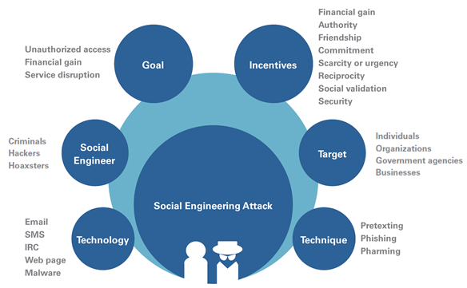
Social Engineering Basics (2 of 3)

Slide 74
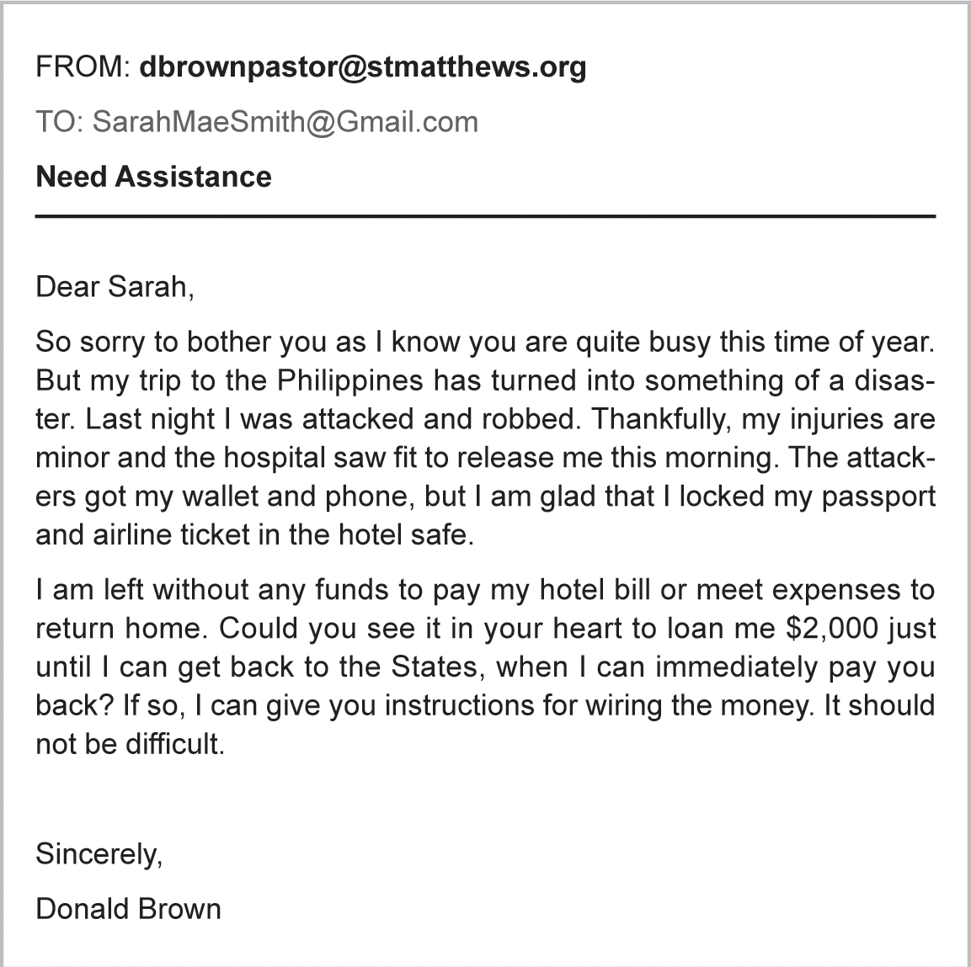
Social Engineering Basics (3 of 3)
The poster child for social engineering scams is called advance fee fraud, in which the victim is promised a large sum of money in exchange for a bank account number from which a small advance fee is withdrawn

Slide 75
Spam (1 of 8)
Spam is defined as unsolicited messages that are usually sent in massive numbers using electronic mail systems; it accounts for approximately 70% of all email
Everyone gets spam; mass-mailing databases obtain millions of email addresses at low costs
In 2003, the U.S. Congress passed a so-called anti-spam law, the CAN-SPAM Act (Controlling the Assault of Non-Solicited Pornography And Marketing Act of 2003)

Slide 76
Spam (2 of 8)
Most ISPs and email services use filtering techniques to block spam coming from IP addresses and senders that are known to generate spam
Spammers have developed techniques to bypass these barriers, and spam continues to make its way into consumer mailboxes
Defending against spam requires careful Inbox management

Slide 77
Spam (3 of 8)
To reduce the amount of spam you receive, consider the following recommendations:
Share your primary email address only with people or businesses that you trust not to distribute it to others. Businesses sometimes share mailing lists with affiliates, and lists may fall into the hands of illegitimate spammers. Keeping your email address off one list can keep it from propagating to multiple lists
Never reply to spam. Mailing lists contain a high percentage of invalid addresses. Replying to a spam message marks your email address as valid, which only generates more unwanted mail

Slide 78
Spam (4 of 8)
Do not click links in spam messages. If you are curious about where a link might lead, hover over it with the pointer and look at the destination URL. Links in spam often are designed to direct victims to fake sites where malware is waiting
Do not open attachments in email messages unless you are certain that the sender is trusted and the attached file is expected
Use a complex email address with a user name that would not be found in a telephone directory. For example, add a number or symbol to your name

Slide 79
Spam (5 of 8)
Use a disposable email address in situations where an email address is required but you don't want to receive solicitations. Disposable email addresses are useful when registering to use Web apps and when signing up for merchant loyalty programs
When displaying your real email address—for example, on your Web site—disguise it by posting it as a graphic. You can create a graphic containing your email address by using graphics software, such as Paint, typing your name, and saving it as a PNG file

Slide 80
Spam (6 of 8)
Use an opt-out link only if the email originated from a reputable national company. Before clicking the opt-out link, hover over it to make sure it leads to a legitimate URL
Remember that if a deal seems too good to be true, it is probably a scam
In iCloud, delete spam before opening it by using Mailto→Preferences→Viewing and deselecting "Display remote images in HTML messages."

Slide 81
Spam (7 of 8)
Be suspicious of shortened URLs that do not reveal the genuine domain
Be wary of email messages addressed to "undisclosed recipients" or addressed to numerous recipients that you don't know
Be cautious of email messages addressed to your email user name rather than your real name
Use the spam filters provided by your email client

Slide 82
Spam (8 of 8)
A spam filter uses a set of rules to examine email messages and determine which are spam
Content filters
Header filters
Blacklist filters
Permission filters

Slide 83
Phishing (1 of 2)
Phishing is an email scam that masquerades as a message from a legitimate company or agency of authority, such as the IRS
The goal of a phishing scam is to obtain private information such as passwords and bankcard numbers
A spear phishing attack is more targeted and typically sent only to members of a specific organization
Some of the most common attacks appear to originate from FedEx, UPS, DHL, or the U.S. Postal Service

Slide 84
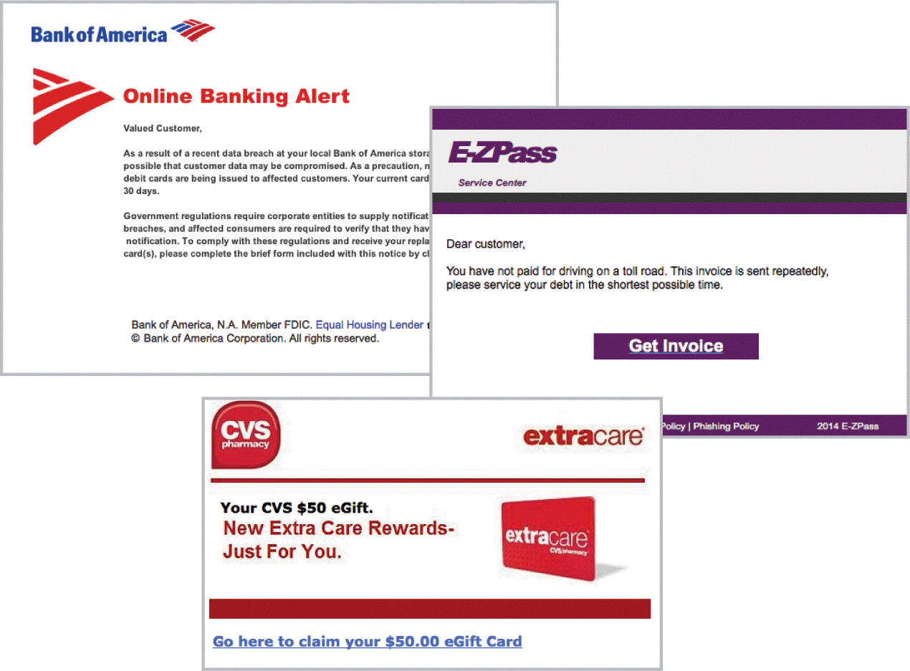
Phishing (2 of 2)

Slide 85
Pharming (1 of 2)
Pharming redirects Web site traffic to fraudulent Web sites that distribute malware, collect personal data, and perpetrate other scams
Safe Browsing is a service offered by Google that checks URLs against a list of suspicious Web site URLs
Chrome, Safari, and Firefox use Safe Browsing to alert users about sites to avoid; Microsoft offers a similar service called SmartScreen Filter

Slide 86
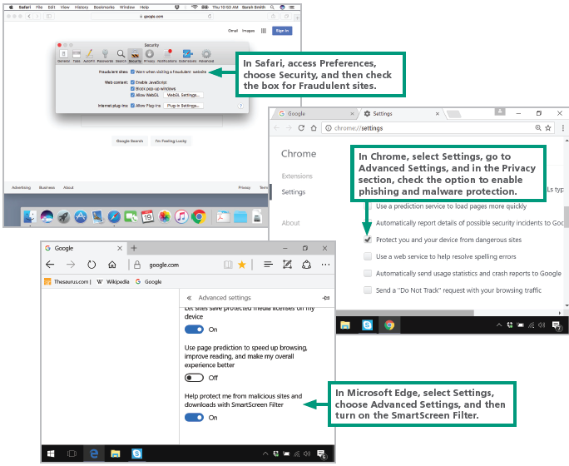
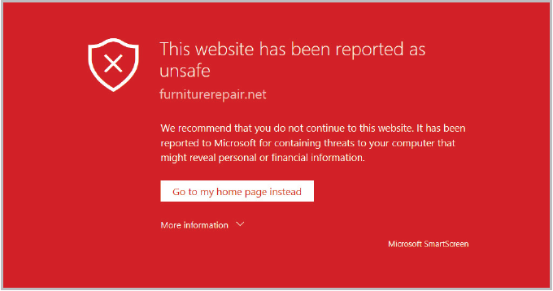
Pharming (2 of 2)

Slide 87
Rogue Antivirus (1 of 2)
A rogue antivirus exploit usually begins with a virus warning and an offer to disinfect the infected device
The goal of this exploit is to trick consumers into clicking a link that downloads malware
Fake virus alerts, which appear in pop-up windows, commonly appear when browsing the Web at slightly sketchy Web sites

Slide 88
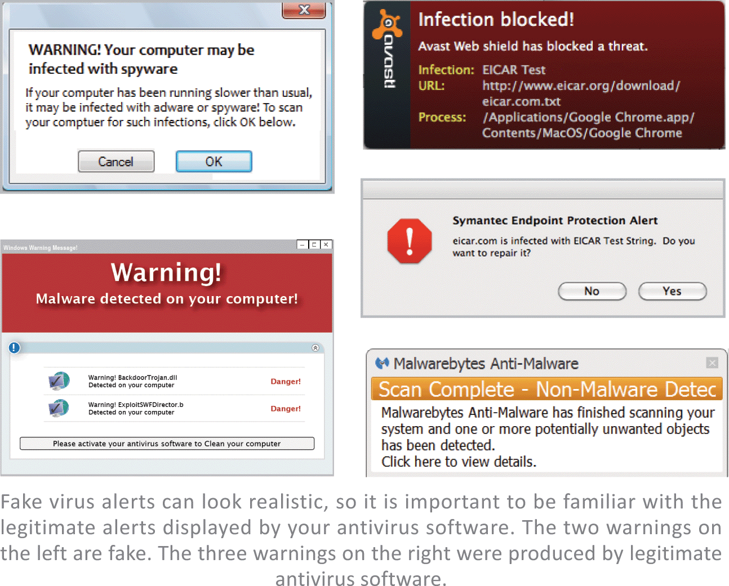
Rogue Antivirus (2 of 2)

Slide 89
PUAs (1 of 2)
The acronym PUP stands for potentially unwanted program
The acronym PUA stands for potentially unwanted application *(both PUP and PUA are used interchangeably)
If you suddenly notice that an odd browser has become the default on your device and your attempts to reset to Chrome, IE, or Safari fail, then your computer is likely to have a PUA
PUAs are installed using social engineering techniques, such as hoping consumers will mistakenly accept a PUA application during software installation

Slide 90
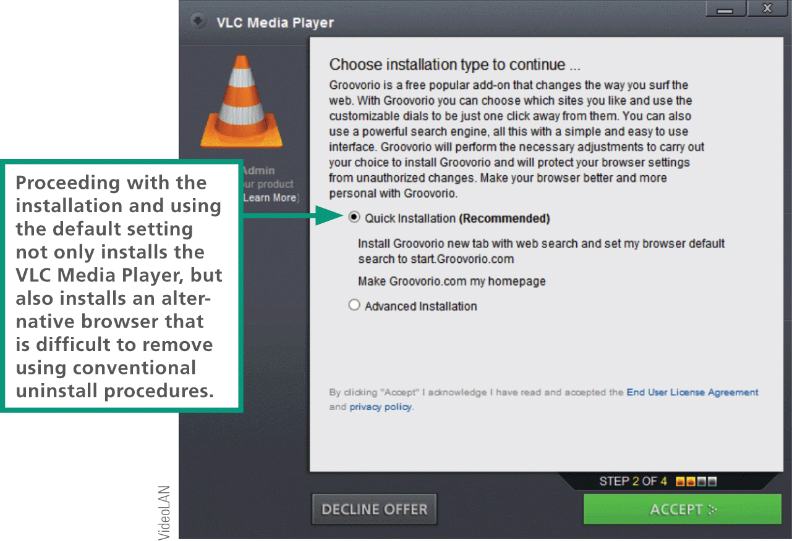
PUAs (2 of 2)

